Slide 1


Bootstrap 4
E-portfolio by Jonas kandels

Slide 2
What is Twitter Bootstrap?
Front-End framework for Uis and themes
HTML/ CSS (SASS)/ JavaScript
Used for building responsive, mobile first web applications and websites
Most popular framework by far

Slide 3
Why Use Bootstrap
Increase development speed
Responsiveness
Consistency
Customizable
Support

Slide 4
What We Will Cover
What is Bootstrap
Installation/ Setup
HTML/ CSS Components
Grid System
Create Bootstrap Cheat Sheet

Slide 5
HTML/ CSS Componets
Navbar & Dopdowns
Jumbotron
Alerts & Progress bars
Buttons & Links
Labels
Icons
Tabels
Grid System
Responsive Utilities
…

Slide 6
Install Methods
Manually Download Source Files
CDN
Bower
NPM

Slide 7
Let’s start Coding!!
Find my Git Repository attached

Slide 8

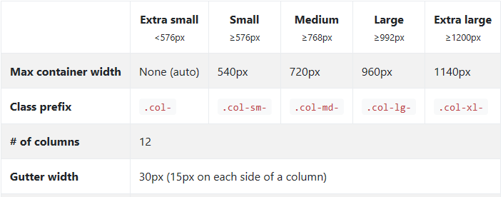



Grid System

Slide 9
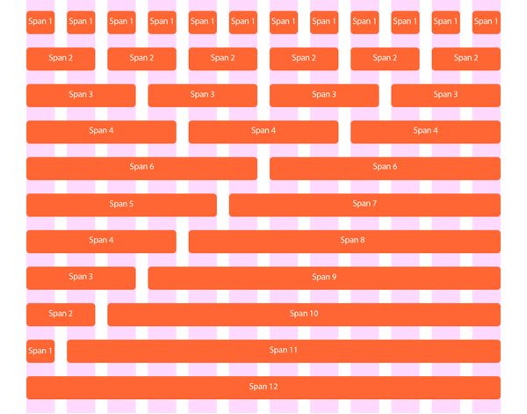
Grid System

Slide 10
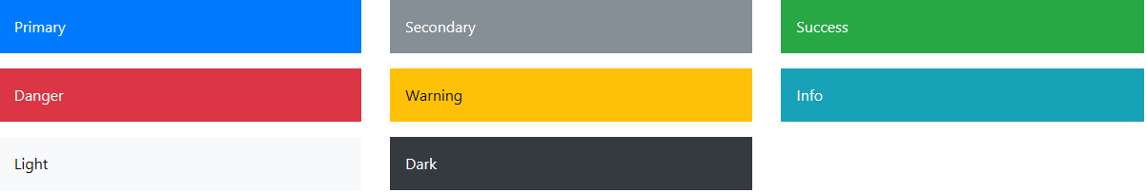
All Theme Colors

